Slide 1
SNS ACADEMY
A fingerprint International School
Affiliated to CBSE New Delhi
Affiliation No :1930610
GRADE XII A (2020-21)
COURSE NAME : BIOLOGY (044)
Chapter-6 MOLECULAR BASIS OF INHERITANCE- DNA REPLICATION ON 4/9/2020

Slide 2
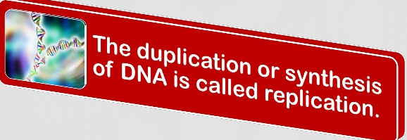
DNA REPLICATION

Slide 3
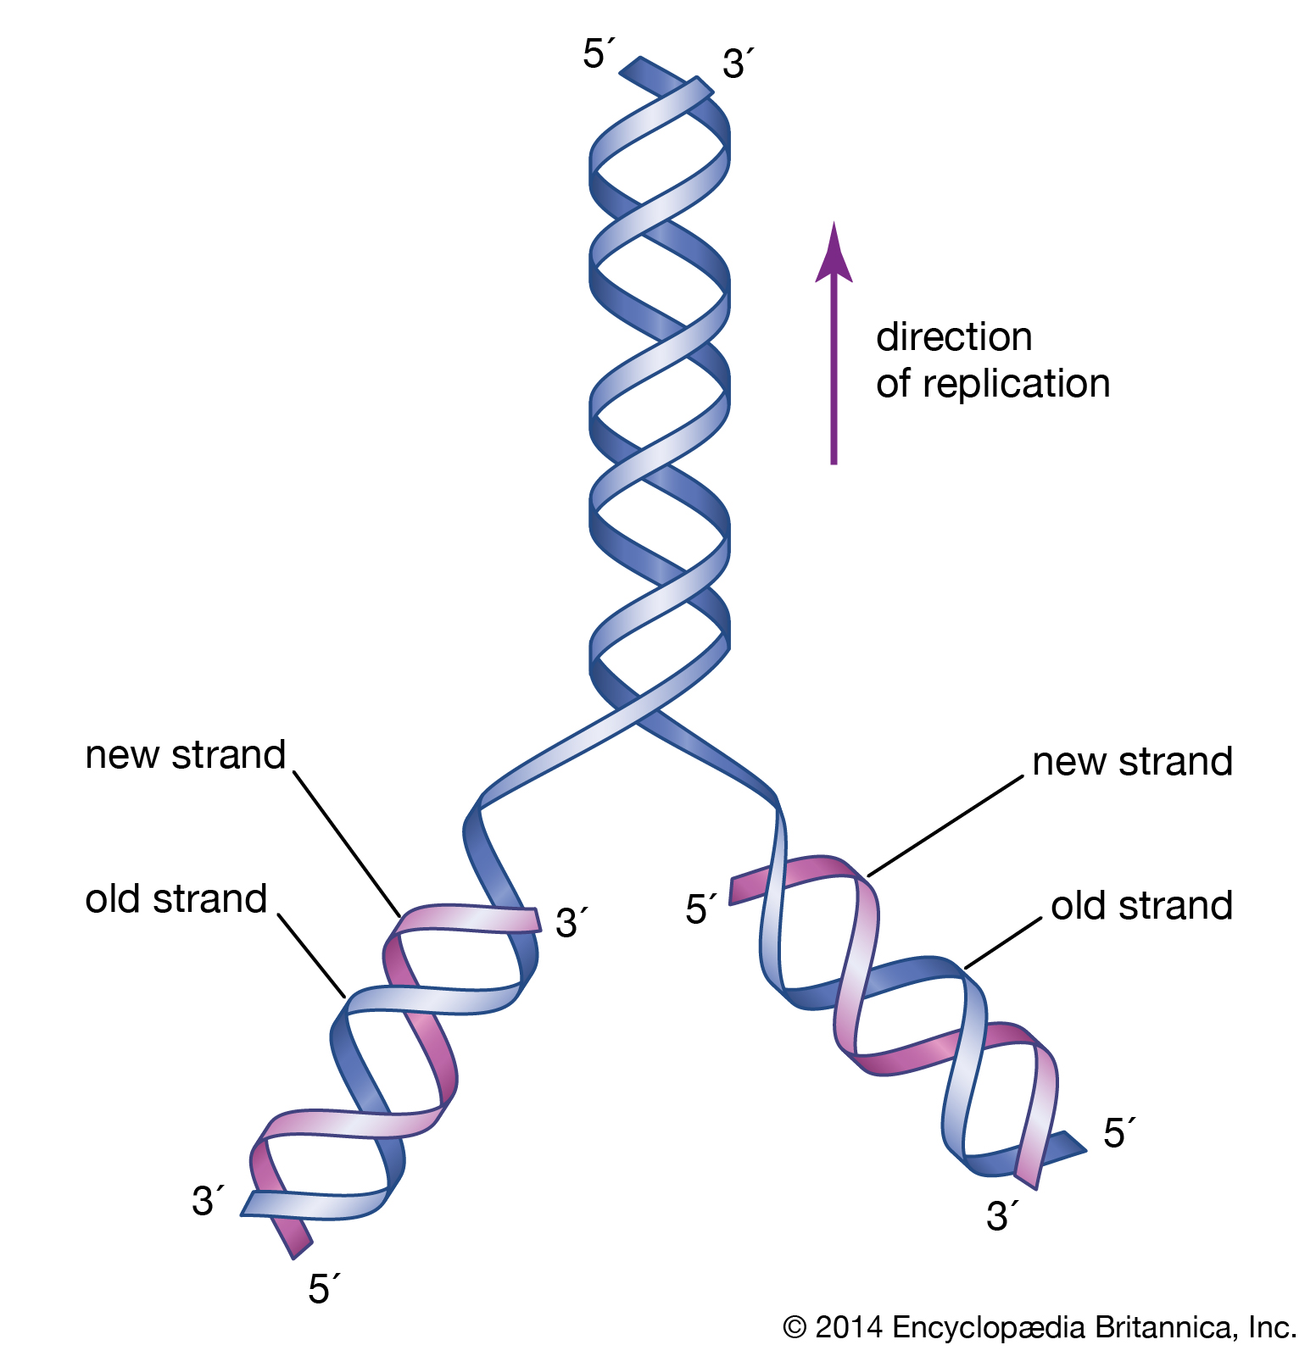
DNA REPLICATION IS SEMI CONSERVATIVE
Each replicated duplex daughter DNA molecule contains one parent strand and one newly synthesized strand.
The base pairing rule is always maintained.

Slide 4
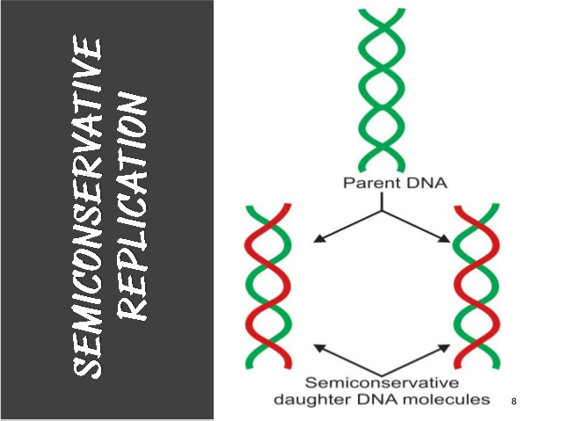

Slide 6
Prokaryotic DNA replication
Replication in prokaryotes is much better understood than replication in eukaryotes.
The basic requirements and components of replication are the same for prokaryotes as for eukaryotes

Slide 9
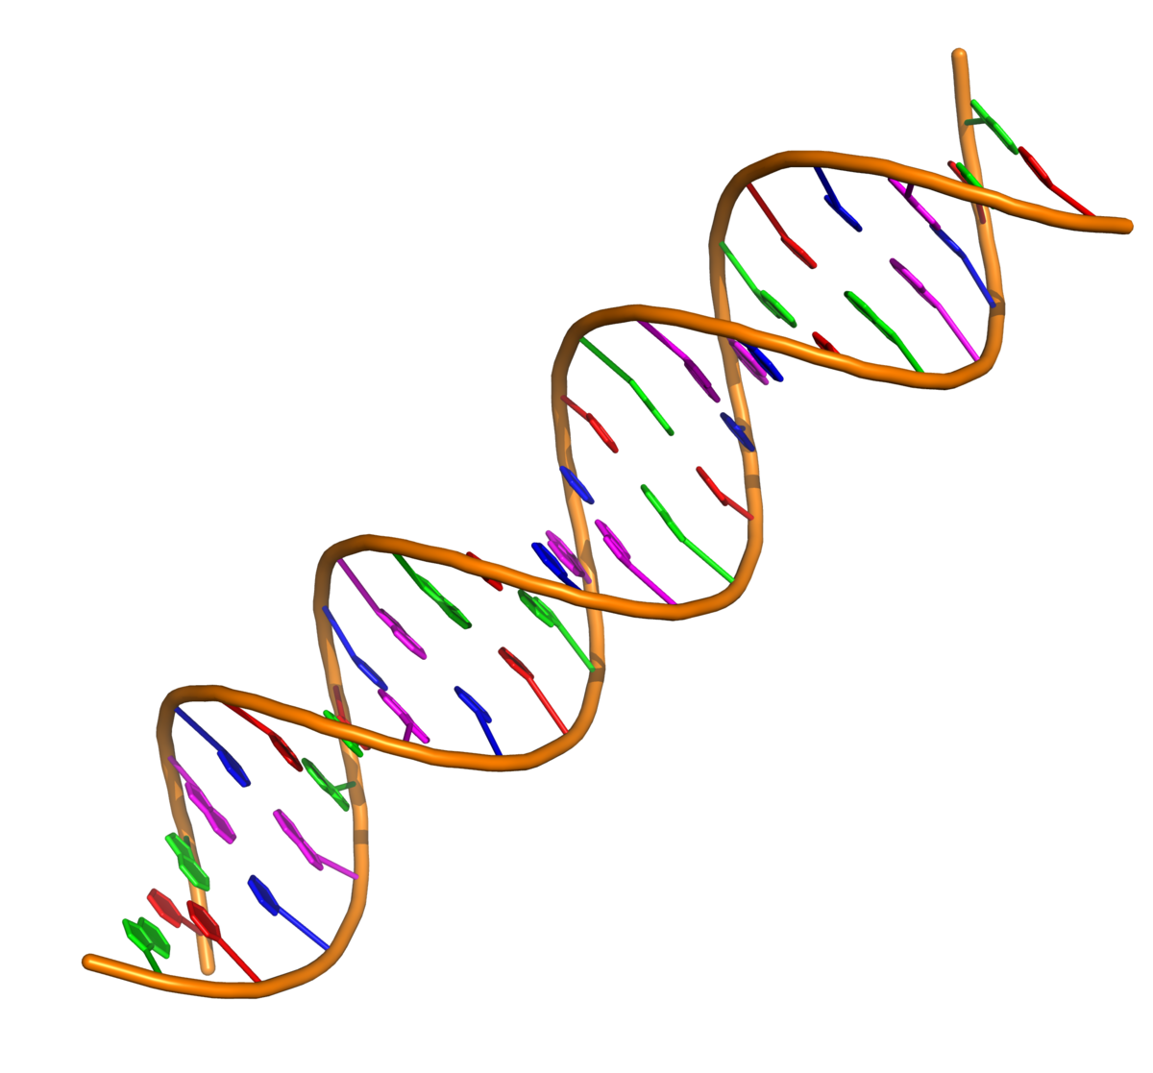
TEMPLATE
Both the strands of DNA double helix serve as template for the synthesis of new daughter DNA strands.

Slide 22
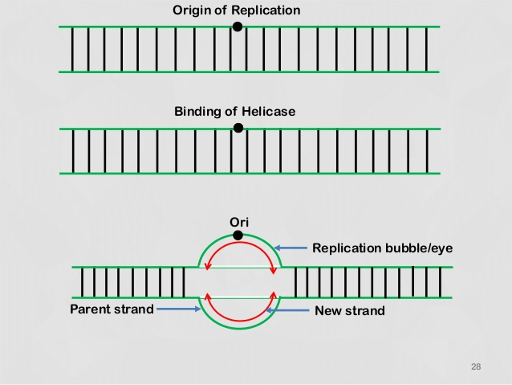

Slide 26
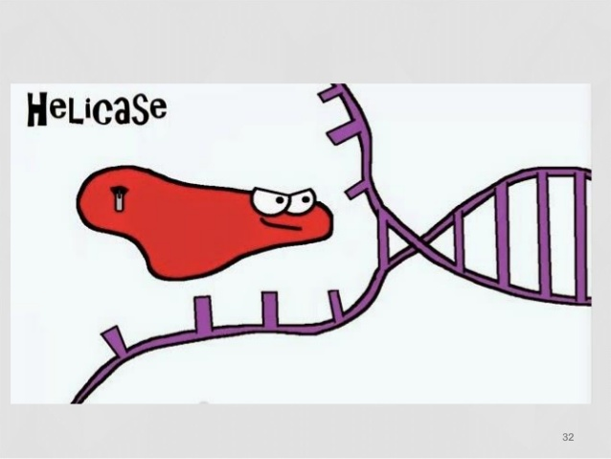

Slide 29
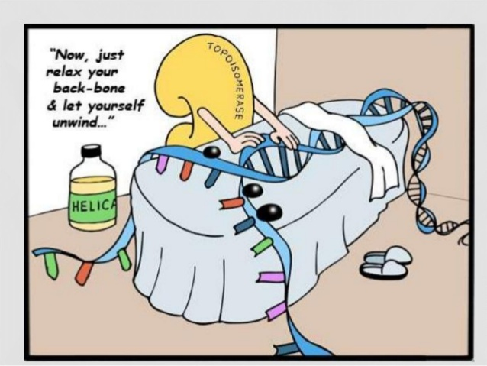

Slide 34
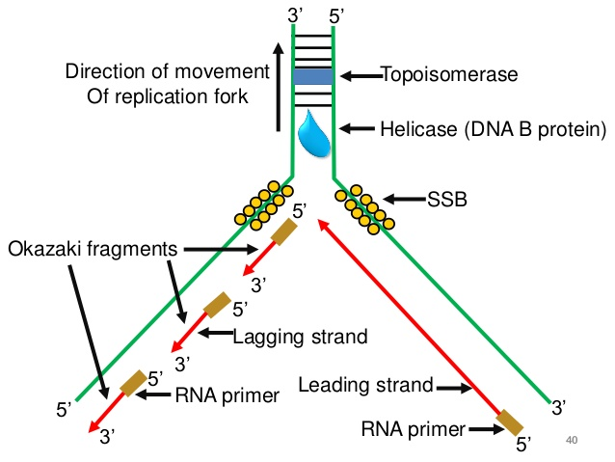

Slide 35
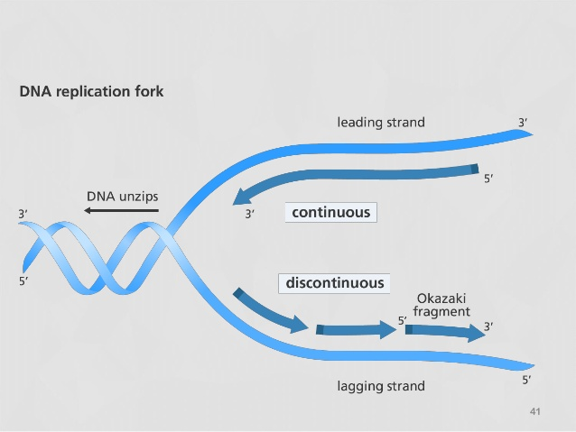

Slide 37
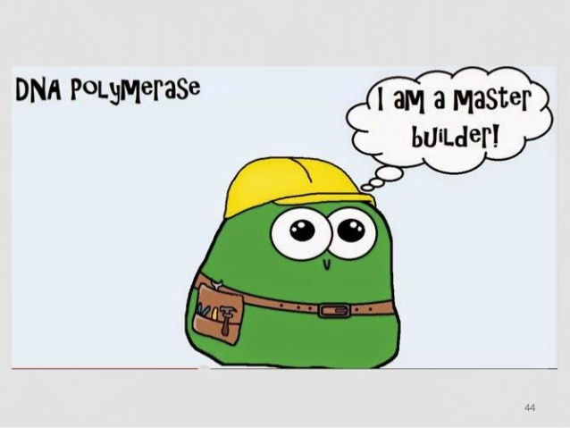

Slide 39
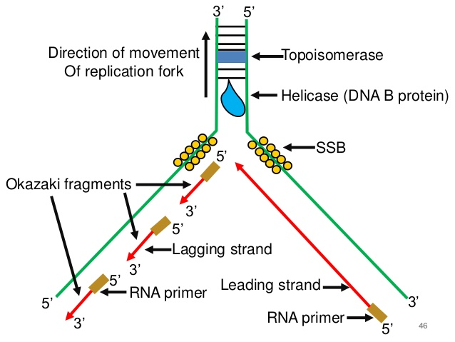

Slide 49
